Slide 1
Chapter 6
Using The Recovery Catalog

Slide 2
Objectives
What is the recovery catalog
Creating the recovery catalog
Granting access to the catalog
Connecting to the catalog
Registering databases
Cataloging older files
Updating recovery catalog
Dropping recovery catalog

Slide 3
Objectives (cont.)
Merging catalogs
Moving catalogs between databases
Creating high-availability catalogs
Viewing backup information
Uncataloging RMAN records
Using 11.x client with older catalogs

Slide 4
What is the Recovery Catalog?
Optional schema storing RMAN repository data
  Data about your backups
Provides metadata redundancy
  Control file always primary storage for repository
Stores configuration settings
Place to store RMAN scripts
Must be created manually
Choose location of recovery catalog carefully
  Must be backed up as well
  Critical, as it contains information needed for recovery
Also known as ‘base recovery catalog’

Slide 5
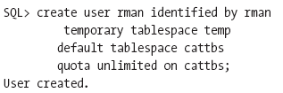


Creating the Recovery Catalog
Two steps to create:
  Create the schema / location to house the catalog
  Create the catalog itself

Slide 6
Creating the Catalog (cont.)
Factors that may affect the size of the catalog:
  Frequency of backups (most important factor)
  Size of the databases being backed up with RMAN
  The number of databases to back up
  The size and number of archived redo logs to back up
  The size and number of RMAN scripts stored

Slide 7
Granting Access to Catalog
Virtual private catalog
  Is a subset of the base recovery catalog
  Granting a user read/write access
  Only granting access to that user’s metadata
Steps required:
  Creating virtual private catalog owner (user)
  Granting recovery_catalog_owner role
  Granting ‘catalog for database’ privilege
  Can also grant ‘register database’ privilege
  For 10.2 and older, other steps required to use VPC

Slide 8
Connecting to Catalog
Connection to recovery catalog always uses Oracle Net
Connection to target database uses O/S authentication or Oracle Net
Need to update listener.ora & tnsnames.ora

Slide 9
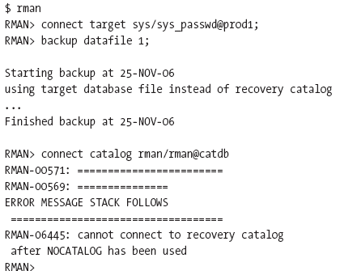
Connecting to Catalog (cont.)
Always specify catalog database when connecting to RMAN (else will use controlfile)

Slide 10

Connecting to Catalog (cont.)
Connecting from the RMAN prompt:

Slide 11
Registering Target Databases
Target databases must be registered in recovery catalog
Steps to register:
  Connect to both target database and catalog
  Start target database in mount state
  Issue ‘register database’ command
  Use ‘list incarnation’ command to verify registration

Slide 12
Registering Databases (cont.)
Upon registration, controlfile metadata is copied into recovery catalog tables
Multiple databases can be registered with recovery catalog
Can synchronize controlfile metadata with recovery catalog if out of sync
Each registered database must have unique DBID

Slide 13
Unregistering Databases
Steps to unregister:
  Connect to both target database and catalog
  Run ‘list backup’ and ‘list copy’ commands and save output (recommended)
  Issue ‘unregister database’ command
Afterward, controlfile is source of metadata
If target database no longer exists, issue unregister command directly from recovery catalog

Slide 14
Cataloging Older Files
Method of cataloging backups into recovery catalog
Done via ‘catalog’ command
Files must reside on disk (not tape)
Must be one of the following types:
  Datafile copy
  Controlfile copy
  Archived redo log
  Backup piece

Slide 15
Cataloging Older Files (cont.)
Can catalog files as part of incremental backup
Can catalog an entire set of files
  Uses ‘catalog start with’ command
  Catalogs files with names starting with given string pattern
  Can also catalog contents of flash recovery area

Slide 16

Updating the Recovery Catalog
Done automatically or manually
  Manually via ‘resync catalog’ command
  Automatically when certain commands are issued
Can be ‘full’ or ‘partial’
Steps to resynchronize catalog:
  Start the target database in mount state
  Issue ‘resync catalog’ command

Slide 17
Updating Catalog (cont.)
Uses controlfile as source for resynchronization
Compares controlfile contents to recovery catalog contents
Set control_file_record_keep_time appropriately based on backup schedule
Information updated during resync:
  Online log switch information
  Archived redo log information
  Backup history
  Database incarnation history
  Physical schema information

Slide 18


Dropping the Recovery Catalog
Done via ‘drop catalog’ command
Required steps are:
  Connect to the base recovery catalog
  Issue ‘drop catalog’ command
  Confirm again by reentering ‘drop catalog’
No need to be connected to target database

Slide 19
Dropping Recovery Catalog (cont.)
Steps identical for virtual private catalog
After dropping, backup metadata lost, unless
  Can restore recovery catalog from backup
  Can retrieve metadata from controlfile
Dropping base recovery catalog makes all virtual private catalog metadata unusable
Can recreate new recovery catalog and then use ‘catalog’ command to record backups

Slide 20

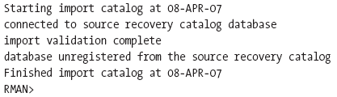
Merging Recovery Catalogs
Used to merge multiple recovery catalogs into one
Done via ‘import catalog’ command
Done without connecting to target database
Can specify individual database to import

Slide 21
Moving Recovery Catalog
Means moving from one database to another
Similar to merging catalogs
Steps include:
  Create a new recovery catalog
  Do not register any databases in it
  Use ‘import catalog’ command

Slide 22
Creating High-Availability Catalog
Done if large number of databases registered in catalog
Becomes critical for production databases
Create a standby recovery catalog
Outline of steps:
  Create secondary recovery catalog in separate database
  Register all databases
  Synchronize second catalog with ‘resync catalog’
  Back up both catalogs on regular basis

Slide 23
Viewing Backup Information
Use database ‘RC_’ views
Contains information for target databases
DB_KEY column = DBID of target databases
Also done via RMAN commands such as ‘list’

Slide 24
Uncataloging RMAN Records
Done via ‘change … uncatalog’ command
Done for two main reasons:
  Update controlfile repository
  Delete a backup record from recovery catalog
Only removes metadata, not physical files

Slide 25
Using 11.x Client and Older Catalogs
Connecting to over recovery catalog generates error
Solution is to upgrade recovery catalog
Done via ‘upgrade catalog’ command
Steps include:
  Select * from rcver; (shows older version)
  Connect to catalog and issue ‘upgrade catalog’ command
  Reissue ‘upgrade catalog’ as verification
  Select * from rcver (shows newer version)

